Slide 1
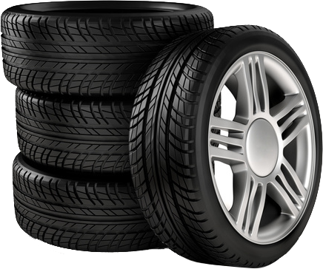
Organization Name : Bridgestone
Problem Statement : Automation in Tire
Visual Inspection
Team Name : Pepehands
Team Leader Name : Harshit Rai
AICTE Code : 1-3508354456

Slide 2





IDEA DESCRIPTION
In early 2000, Ford faced a loss of about $ 5.5 billion due to the manufacturing defects in the tyres used with the Ford Automobiles.
The above incident proves that the manufacturing defects must be identified and dealt in the manufacturing stages itself.
The visual inspection is a part of the Quality Assessment (QA) testing done to ensure the quality of the manufactured units.
However, manual inspection of every unit is very hectic and a slow process that may even introduce errors due to various factors.
We propose “The Tyre Inspector”, a real-time, AI-enabled visual inspection system which can be used for quality insurance.

Slide 3










A set of high resolution cameras will be installed over the conveyor belt as a part of this system.
These cameras will capture images from various different perspectives, covering all inspectable areas of the tyre.
These images will be then fed to the tyre “Type-detection” module which will identify the type of tyre under observation.
After this, the images will be fed to the module which will identify the defects and predict the quality of the tyre.
If the tyre is found to be defective, the QA team will be notified regarding the same.
The visual inspection process will end with the generation of a report which will contain the detailed description of the inspection.
TECHNOLOGY STACK
Tensorflow : For building and training machine learning models.
Python : For the development of the core system.
OpenCV : For real-time image processing and manipulation.
NoSQL : For storing and retrieving
Inspection data which will be used to generate reports.

Slide 4



USE CASES
SHOW STOPPERS
1: Can be used to provide after sales
customer support by the means of a
mobile application.
2: Can be used to facilitate tyre inspection
at service centres.
3: Can be used as a smart recommendation
system to advice whether a particular
tyre requires repairing or replacement.
1: Inspection of tyres using Computer
Vision reduces the time and cost
involved in conducting inspection.
2: The ‘Tyre Inspector’ would provide
higher accuracy and precision than
manual visual inspection.
3: Providing the ‘Tyre Inspector’ to the
users as an after-sales service would
improve the customer relationship.

